Slide 1

Software Engineering Best Practices
Elijah Kerry, Certified LabVIEW Architect (CLA)
Senior Product Manager for LabVIEW, National Instruments
Notes:
Presentation Brief
As software becomes rapidly more complex and plays a growing role in mission-critical applications, developers need to abide by established software engineering practices in order to ensure that an application is reliable, safe and fault tolerant. This presentation will examine the typical development life cycle and explain the best practices and recommendations for programming with LabVIEW in a structured development environment. Topics will include configuration management, tracking and identifying changes that are made to code, requirements gathering, code architecture, ensuring proper style guidelines, validation of code, dynamic code analysis, and professional deployment practices.*
*due to time constraints, not all of those topics may be covered.
Over the last 22 years we’ve seen many innovations in LabVIEW that have made new and amazing applications possible. LabVIEW has its roots in virtual instrumentation, where it is still strong, but today LabVIEW is being used as a true programming language, for graphical system design. As the use of LabVIEW for large applications increases it’s becoming increasingly important that developers use sound programming practices in order to ensure that they’re developing a high quality application.
Even if you aren’t developing large, complex, mission-critical applications, the same practices and tools will help ensure that your applications are delivered on-time and help maximize quality and efficiency, while reducing costs and mitigating problems caused by oversights in programming.
In this presentation we’re going to examine some of the best practices and the tools that are available for these large applications that aide us in software engineering.

Slide 2
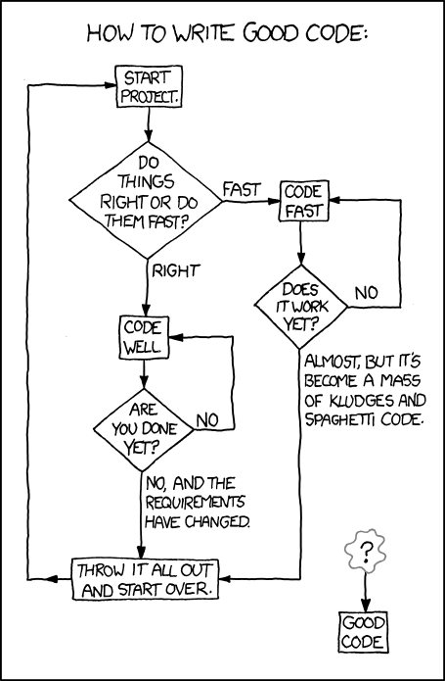
Notes:
Optional: Put this up while people are coming in and getting settled

Slide 3
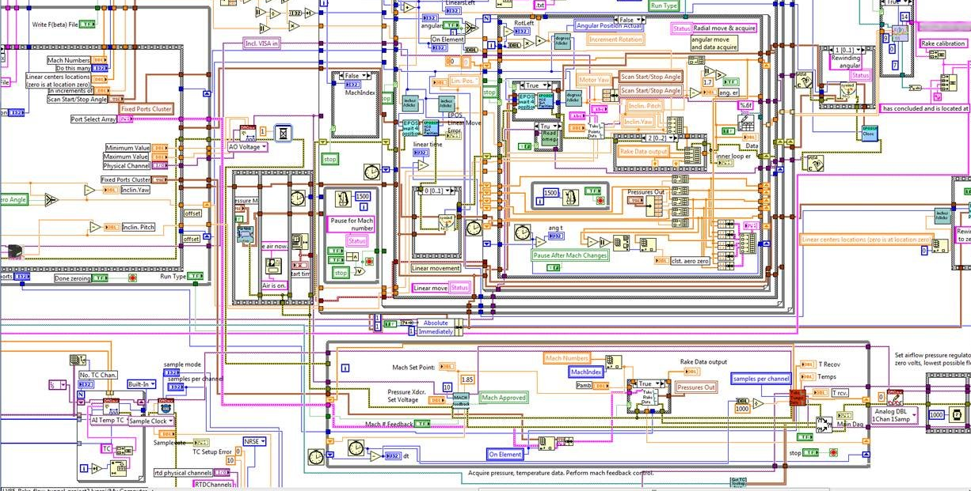

Slide 4
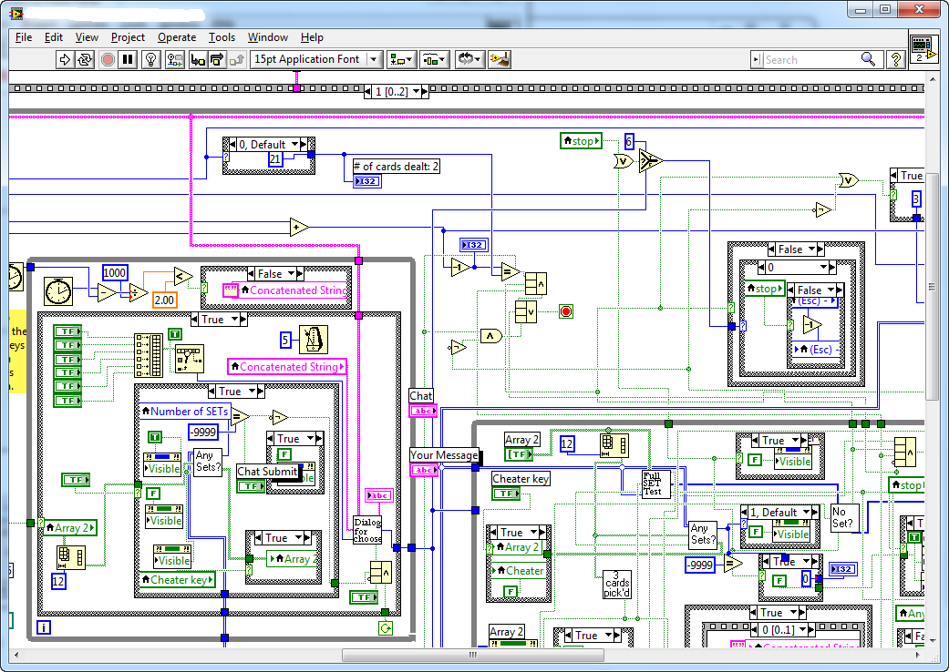
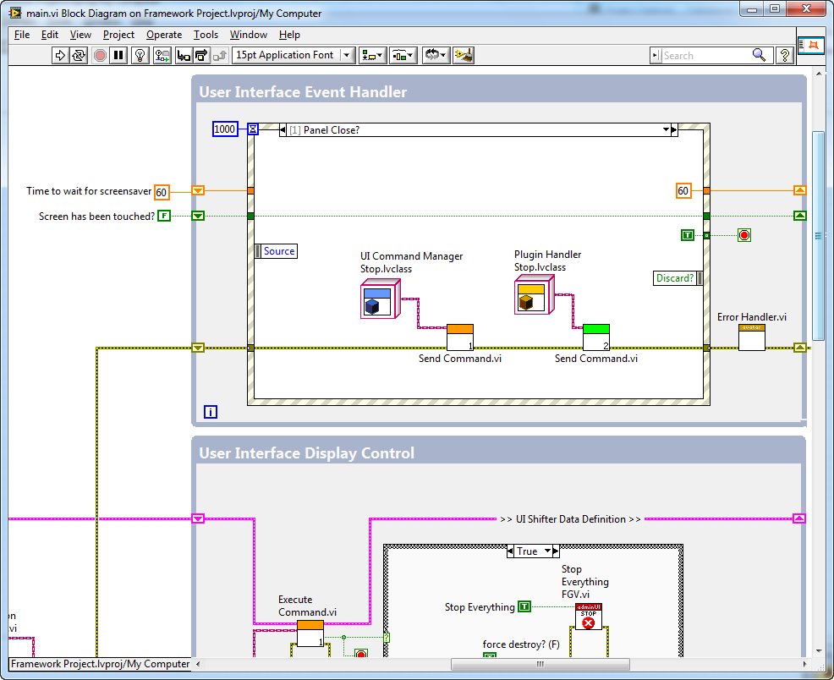
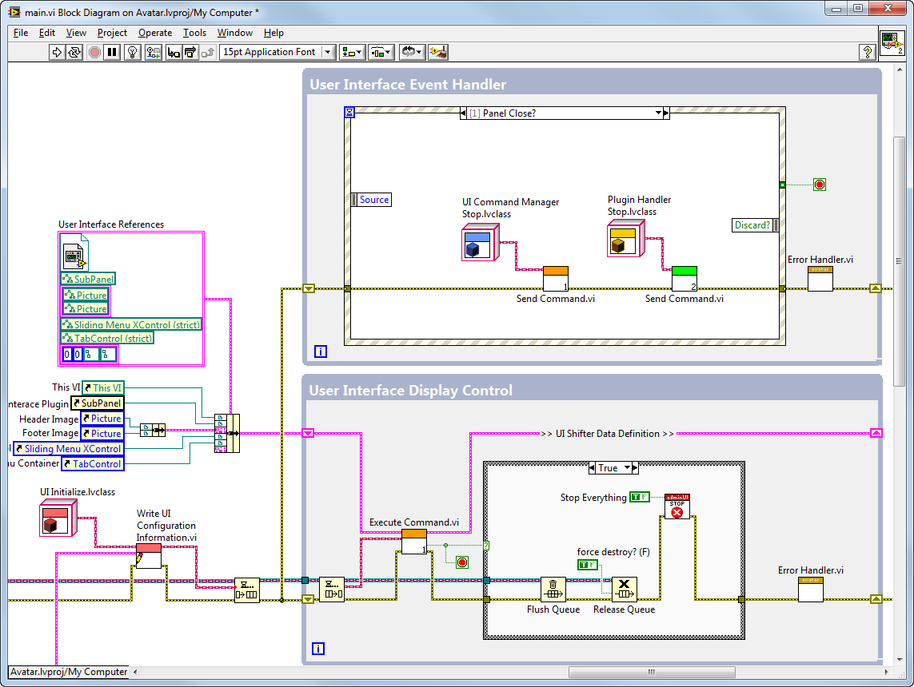
Notes:
“This is honestly one of my favorite slides to show customers, because I think most of us here (myself included) can probably relate to seeing a diagram that looks something like this. In the spirit of not calling anyone out, we’ll assume that we’ve all inherited or been given these diagrams by people who aren’t in this room. Right off the bat, we should recognize a lot of major problems… there is no obvious design pattern, no documentation, no VI icons, wires crossing wires, etc. In spite of all that, the absolute worst aspect of this diagram, the thing I hate the most… is that this code actually runs. (pause here, you can almost always get a laugh) This program is actually a working program…. As a result, people who are not proficient LabVIEW users (ie: managers) may not recognize the risk and cost associated with maintaining this over a long time.
So what happens when someone hands us this program and says, ‘I need you to fix a bug or add a feature?’ It sounds simple to them, because they don’t realize how poorly written this code is and now it’s up to you to either work nights and weekends to figure it out, or convince them that the application really needs to be completely re-factored. This is why it’s so important that we be able to measure and analyze the quality of code, gauge the skill-level of our developers, and that we have established style-guidelines and coding practices within our team to enforce standard design patterns.”
<<build to next slide>>
“This diagram illustrates what our code should look like (it’s not totally perfect, but it definitely lends itself to reuse and longevity. It uses a highly-recignizeable producer/consumer design pattern, has a proper amount of documentation, it’s easy to follow the wires, VIs have icons, etc.. So the topics discussed in this presentation are intended to help us write code that looks more like this and recognize when someone writes awful code like we just saw in the previous diagram.”
“One final note: I find that when someone writes a bad C program.. Everyone instantly knows that it’s the C programmer’s fault. However, when someone writes bad LabVIEW code, LabVIEW tends to get blamed. One very important thing to remember is that graphical code is a programming language just like any other, and as such, we need to be sure to apply the same software engineering practices.”

Slide 5
Examples of Software Engineering Debt (just some of the most common LabVIEW development mistakes)
No source code control (or Project)
Flat file hierarchy
‘Stop’ isn’t tested regularly
Wait until the ‘end’ of a project to build an application
Few specifications / documentation / requirements
No ‘buddying’ or code reviews
Poor planning (Lack of consideration for SMoRES)
No test plans
Poor error handling
No consistent style
Tight coupling, poor cohesion
Notes:
Lets start by looking at some of the most common mistakes. These are all common examples that can lead to the duct-tape and hot-glue diagram like the one we just saw. As engineers, we all appreciate the cost of cutting-corners or taking a short-cut… it may get us there sooner, but at what cost? In the world of software, there’s a concept known as ‘Software Engineering Debt.’ If we cut corners, we take on more debt, and these are all examples of how we do that. The more debt we take on, the more interest we accumulate over time, and as we’ve all seen in the recent years, that debt can quickly pile up and accumulate a mountain of interest, making it more expense the longer we wait. If we wait to pay down that debt until after we release a version of the software to our customer, it’s going to painful and the bugs will be much more costly than if we’d caught them up front.
The practices we’ll look at in this presentation will help address most, if not all of these, but do want to mention a few right now. (I recommend picking a few to really emphasize… here is some additional information on each to allow you to decide
No source code control (or Project) – if you’re not using it, you’re playing with fire. Even for a small project with one developer, these tools can save you a tremendous amount of time and heartache.
Flat file hierarchy – ever had trouble identifying the top-level VI in an application? It’s not just an organizational problem, it indicates a lack of encapsulation and proper design. Use folders, encapsulate your code and make APIs obvious from private subVIs
‘Stop’ isn’t tested regularly – there are lots of ways to assess the health of an application, but this is an easy one that you should always be thinking about. A new feature is no good if it impedes expected behavior and one key indicator is whether or not the application still stops instantly when asked to
Wait until the ‘end’ of a project to build an application – if you’re one of those that waited until you were ‘done’ to build an exe for the first time, you’re probably a long ways away from done. The reality is that, as with any language, a lot of things change in the RTE, and you need to test this on a regular basis
Few specifications / documentation / requirements – this is perhaps the most common mistake and the easiest way to ensure that code is not reusable or maintainable
No ‘buddying’ or code reviews – sometimes the mere act of explaining your code to someone else finds major problems or bugs… do it, and do it often
Poor planning (Lack of consideration for SMoRES) – This acronym stands for ‘Scalable,’ ‘Modular,’ ‘Reusable,’ ‘Extensible,’ and ‘Simple.’
No test plans – you can’t test code if you don’t define how it should behave.
Poor error handling – does it stop? Does it tell the user an error? Does it log the error? If you don’t plan for this early, a simple error can lead to even more problems
No consistent style = not readible, not maintainable
Tight coupling, poor cohesion – impedes reuse
A lot of us are under pressure to get things done quickly and to hit aggressive deadlines, but there are a few practices that if we invest in early, will pay dividends down the road.
Any are all of these are topics I’m happy to talk about in-depth. In fact, if you’re interested, we can arrange a presentation for you and your colleagues on any of these that you're interested in.

Slide 6
The Cost of a Software Defect
Development Phase | Cost Ratio
Requirements | 1
Design | 3-6x
Implementation | 10x
Development Testing | 15-40x
Acceptance Testing | 30-70x
Post Release | 40-1000x
Based on an analysis of 63 software development projects at companies including IBM, GTE and TRW
Notes:
After an analysis of 63 software development projects at companies such as IBM, GTE, and TRW, we see that the cost of finding a problem early in the process is far less expensive.

Slide 7
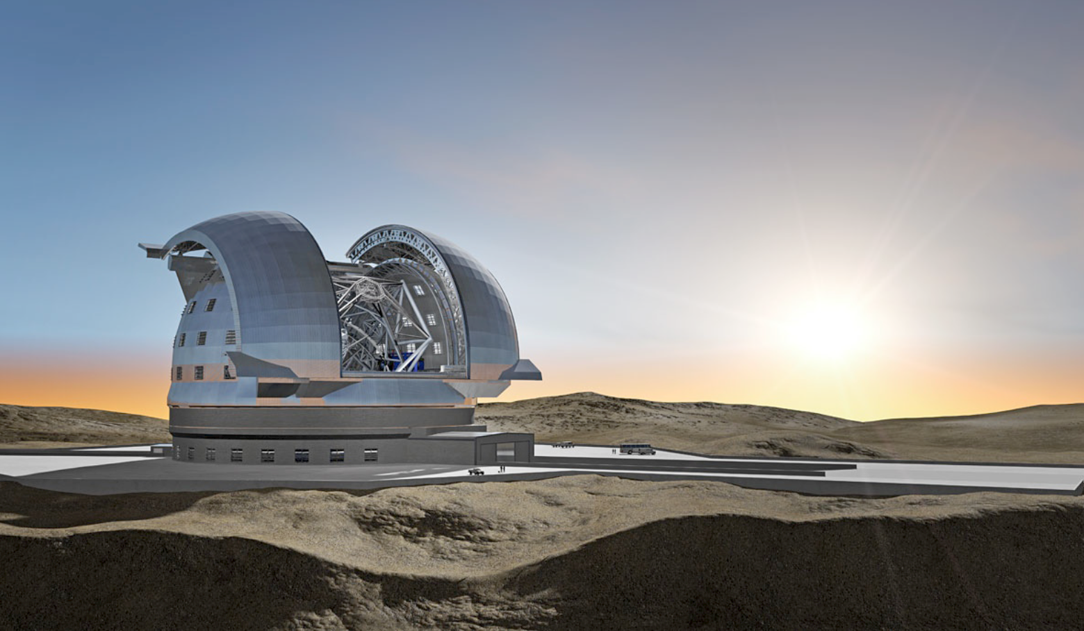
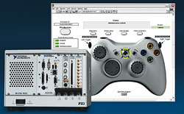

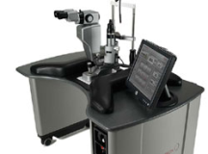

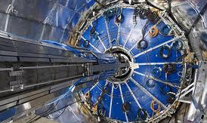

High-Volume Production Test
Structural Health Monitoring
Medical Devices
Robotics and Mechatronics
Large Physics Applications
Avionics Applications
Large System Development
Powered by LabVIEW
Notes:
Before we start looking at some of the practices, I just want to take a look at the nature of LabVIEW applications that are being developed today. As many of you know, LabVIEW is often associated with lab automation and bench-top measurements, which are often simple in nature. However, the biggest differentiator for LabVIEW is the fact that it makes getting real world signals into software simple and easy, where the data can be used for analysis and control of applications. Since I/O and data analysis is a very important part of many of these large and complex applications we’re looking at, so it should be no surprise that LabVIEW is being used at the heart of many of these applications.
Now, how you define ‘large’ or ‘critical’ depends on who you ask. Of course, any application that can potentially impact the welfare or safety of people is important, but someone responsible for a production test application of a consumer product would certainly argue the critical nature of this type of application – if the line goes down, someone is loosing a lot of money by the second. In a lot of cases, the biggest risk is that the company’s reputation is riding on the line. So, no matter whether you fall into any of these categories, or you’re still just writing simple applications, being mindful of the practices and tools we’re looking at will help save you time in the long-run, as well as help you mitigate the risk or problems or failures in deployed applications.
Note to Presenter: Please make sure to research at least two of these examples to speak at length on. If you prefer to have a slide for the example, some hidden slides are included at the end of this presentation. Additional slides can be downloaded from niweb/largeapps.

Slide 8
Topics
Configuration Management
Requirements Tracking
Architecture and Design
Coding Styles and Standards
Testing and Debugging
Documentation
ni.com/largeapps
Notes:
Slide Recommendation
-Use this slide as an opportunity to gauge the interest level of the attendees and current competence. Appropriate questions include:
“Who here is lucky enough to start a project with some form of requirements?” (and if you want a laugh…) “Okay, who here wishes they started projects with some form of requirements?” The reality is that requirements is a very important part of the development process, but it’s also considered extremely tedious and time consuming, so we’ll look at ways to automate some of the more arduous parts of requirements management
“Has anyone here established their own style guidelines or code review criteria?” If they have, advise them that there are tools we’ll look at (VI Analyzer) that will help them screen for good style and even create their own tests
-Be sure to say something to the effect that all of these topics could easily warrant their own day-long seminar, but we’ll do our best to cover the main points from each
This presentation may feel like a fire-hose of information, but don’t worry – the link shown here provides in-depth information on all these and other related topics. We’ll show the link again at the end of this presentation

Slide 9

Software Engineering V-Model
Prototyping
Service
Requirements Gathering
Review and Test
System Testing
Development
Verification
Application Architecture
Integration Testing
Module Architecture
Unit Testing
Deployment
Notes:
Software development best practices are synonymous with software engineering. Software engineering has a lot of different representations and illustrations – the one shown here is probably the most common and recognizable. The reason that the two are so intertwined is that software engineering processes basically consist of organized development phases, each of which prescribe a set of practices and guidelines that should be followed, reviewed and enforced before moving on to the next phase.
If you look closely at this diagram you’ll notice that it begins with the defining of requirements for the product. These are often high level and are often developed through discussion with the customer or end-user.
One thing to realize is that the level of criticality directly impacts how granular you have to be in this process. You may not need to spend any formal time architecting your application or the specific modules of code, but these are typically very important for large, complex systems.
There are several SEP models, such as Waterfall, Spiral and Agile, but they all share common ground in terms of having these various phases and tasks that have to be completed. Many companies today are leaning more towards increasingly agile methods. Basically, this means that for many it’s unrealistic to abide by a waterfall method, in which you work on a particular phase, then agree that you’re done and move on. In reality, complex applications require a lot of back and forth between these different phases. For example, something in the prototype stage doesn’t work as expected and therefore require a new definition for how a particular part of the application will operate, thereby impacting requirements documentation and other components such as the test framework. We’ll look at how to address some of these common challenges in just a few slides..

Slide 10

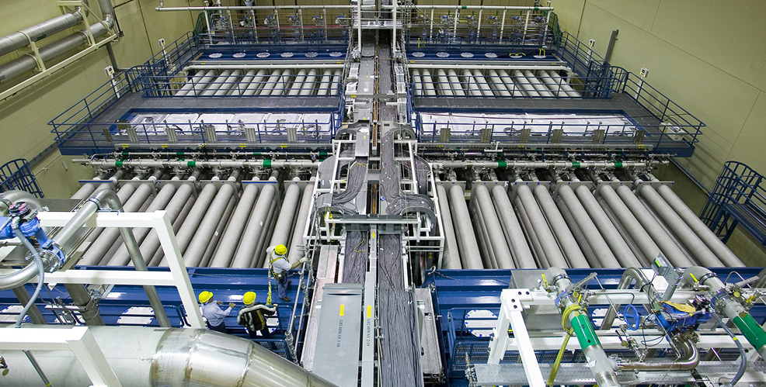
Lawrence Livermore National Labs Developed automated maintenance process for world’s most energetic laser array at the National Ignition Facility using NI LabVIEW and PXI
LabVIEW increased productivity by 3X over Java and C++
Developed complex application consisting of over 1,000 VIs
Applied software engineering practices to ensure quality
“The value in using the graphical dataflow language is the speed in which a team can deliver a robust solution while still using proper software engineering practices.
Glenn Larkin, LLNL
An overhead view of one of the main laser chambers
Notes:
The National Ignition Facility (NIF) at Lawrence Livermore National Laboratory is home to the world’s most energetic laser and largest precision optical instrument. A ten story building the size of three football fields houses 192 lasers, which when fired, travel over 1,000 feet through a series of amplifiers and optics to deposit up to 500 trillion watts of power for 20 billionths of a second on a target the size of a BB. High-energy-density physics experiments being conducted at NIF seek to help assure the safety of the nuclear stockpile and demonstrate the viability of nearly unlimited alternative energy sources based on inertial confinement fusion (ICF).
NIF’s high-energy lasers can initiate tiny micron-scale damage sites on the surface of precision optical lenses, which if left unattended, could eventually degrade the performance of the optic. To ensure cost-efficient operation of the multi-billion dollar machine, scientists and engineers at NIF created an automated maintenance process in the Optics Mitigation Facility (OMF) that uses lasers, vision systems, motorized positioners and diagnostic instruments to repair the damage sites and thereby extend the life span of the optic.
National Instruments LabVIEW was selected as the software to control the inspection and laser-based repair processes for the lenses based on the ready availability of required instrument drivers and control interfaces. Due to the critical nature of the OMF application, software engineering practices and extensive testing were applied to ensure reliable and safe operation of the software and the equipment.

Slide 11

Language Characteristics
Dataflow
Graphical
Event-driven
Multithreaded
Object-oriented
Compiled
Multi-platform
Multi-target
Memory managed
Synchronous

Slide 12
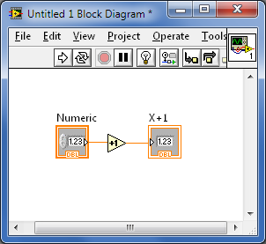
LabVIEW Compiles Graphical Code
mov byte ptr [esi+29h],0
mov eax,dword ptr [esi+18h]
mov ebp,dword ptr [esi+14h]
mov dword ptr [esi+0Ch],eax
cmp byte ptr [esi+2Ah],1
je 0ABFFE0F
mov eax,dword ptr [esi+1Ch]
mov eax,dword ptr [eax+14h]
test eax,eax
je 0ABFFCEF
cmp byte ptr [eax+2Ah],1
jne 0ABFFCEF
jmp 0ABFFE0F
mov ecx,dword ptr [ebp+44h]
xor eax,eax
mov edx,1
lock cmpxchg dword ptr [ecx],edx
test eax,eax
jne 0ABFFCEF
mov eax,dword ptr [esi+1Ch]
lea ecx,[ebp+4Ch]
mov dword ptr [eax+10h],ecx
mov dword ptr [ebp+68h],eax
mov dword ptr [ebp+48h],esi
cmp dword ptr [eax+14h],0
jne 0ABFFD90
mov dword ptr [eax+14h],esi
mov byte ptr [ebp+1Eh],1
cmp dword ptr [esi+30h],2
je 0ABFFE39
mov byte ptr [ebp+1Bh],1
mov esi,dword ptr [ebp+360h]
mov esi,dword ptr [esi]
mov dword ptr [ebp+37Ch],esi
inc dword ptr [ebp+37Ch]
mov esi,dword ptr [ebp+48h]
cmp byte ptr [esi+3Dh],1
mov eax,dword ptr [ebp+68h]
je 0ABFFE09
cmp dword ptr [eax+28h],0
jne 0ABFFE1F
mov dword ptr [ebp+48h],0
mov dword ptr [eax+10h],esi
mov byte ptr [ebp+1Eh],0
mov ecx,dword ptr [ebp+44h]
mov dword ptr [ecx],0
cmp dword ptr [eax+14h],esi
jne 0ABFFE0F
mov dword ptr [eax+14h],0
cmp byte ptr [esi+29h],5
jne 0ABFFE0F
mov dword ptr [esi+29h],2
xor eax,eax
jmp 0ABFFD13
mov dword ptr [esi+1Ch],eax
mov dword ptr [eax+10h],esi
mov edx,dword ptr [esi+8]
mov ecx,dword ptr [esi+0Ch]
mov eax,esi
add esp,8
pop esi
mov ebp,edx
jmp ecx
add ebp,3Ch
mov dword ptr [esp],ebp
call SubrVIExit (24D6450h)
test eax,eax
je 0ABFFE02
mov esi,eax
jmp 0ABFFE0F
mov byte ptr [ebp+1Bh],0
jmp 0ABFFD90
Compiler
Notes:
First off, LabVIEW has a Compiler?
Yes, G is a compiled language, which can be surprising because during typical LabVIEW development, there is no explicit 'compile' step. Instead, you make a change to your VI and simply press the 'run' button to execute it.
But here’s the reality: You wrote some G code, but the computer doesn’t understand G inherently, so LabVIEW has to send your code through the compiler, which interprets it, optimizes it, and generates the machine code that your computer’s CPU can understand. Here I’m showing some assembly code for the G diagram on the left. Look, there’s the increment! (Aren’t you glad we generate the machine code so you don’t have to?)

Slide 13
Layers of Transforms Optimizes Code
DataFlow Intermediate Representation (DFIR)
High-level graph-based representation
Preserves execution semantics, dataflow, parallelism, and structure hierarchy
Developed internally at NI
Low-Level Virtual Machine (LLVM)
Low-level sequential representation
Knowledge of target machine characteristics
3rd party, Open Source
Block Diagram
DFIR
Transforms
LLVM
Transforms
Target Machine Code
Notes:
After DFIR comes the “Low-Level Virtual Machine”. LLVM is a versatile, high-performance open source compiler framework originally developed as a research project at the University of Illinois. LLVM is now widely used both in academia and industry due to its flexible, clean API and non-restrictive licensing. LLVM is a much lower-level intermediate representation, and has knowledge of target machine characteristics, like instruction sets and alignment, which enables it to provide a wide array of low-level optimizations like instruction scheduling and register allocation. By leveraging LLVM, LabVIEW gains access to a rich set of additional optimizations “for free”, and since it’s open-source, we can customize it to fit our specialized needs.
Each of these two new layers is a new “intermediate representation” that provides a framework for the LabVIEW compiler to alter the execution of your code without affecting how it appears on the block diagram. Some optimizations can only be done in DFIR, others only in LLVM, and some make sense in both representations. DFIR and LLVM work in tandem so the LV optimizing compiler can produce more efficient executable code.

Slide 14

Size of LabVIEW Applications
Source: 2010 ni.com/largeapps survey
Notes:
People are developing larger applications with more code, which introduces greater complexity. You can see that based on this survey, a majority of people have at least 250 VIS in their application

Slide 15
Average Number of Developers Per Project
Source: NIWeek 2008 Software Engineering Survey
Notes:
And a majority of LabVIEW projects are at least 3 developers. I use this slide to point out that larger code bases haven’t necessarily required significantly larger teams – most LabVIEW projects are worked on by no more than 3 people, which speaks to the productivity benefits to be gained from using LabVIEW. That being said, there are some projects that have much larger groups of people working on them, which further underscores the need for SCC.

Slide 16
Source Code Control
Requirements Gathering
Application Architecture
Development
Debugging & Testing
Deployment
Software Configuration Management
Merger
Developer 1
Code Revision
Locked for edit
Checked Out
Checked In
Get Latest Version
Code Repository
Checked Out
Checked In
Checked Out
Checked In
Developer 2
Notes:
This is an illustration of how source code control improved the development process, in particular, for team-based projects. Instead of just copying code, developers now use source code control to check it out. This is effectively a developer’s method for information a higher authority (in this case, the SCC provider) that they have an intent to modify the source code.
At this point, the behavior and limitations of the SCC interface are setup at the discretion of an administrator. Some may choose, for example, to lock the code when someone has indicated they choose to modify. Others may allow multiple users to have it checked out simultaneously.
If it becomes necessary to combine changes made by developers to the same piece of code, SCC can help with merging by allowing the two copies of the file to exist in the repository. Additionally, merge is available via the command line, so the automated LVMerge functionality can be invoked in the same manner as many text based merge applications.

Slide 17
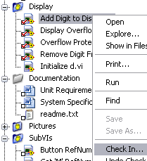
SCC Options for Integration within LabVIEW
Native LabVIEW Integration
Perforce
Integration Through Standard API
Microsoft Visual SourceSafe
Microsoft Team System
Rational ClearCase
PCVS (Serena) Version Manager
MKS Source Integrity
Seapine Surround SCM
Borland StarTeam
Telelogic Synergy
ionForge Evolution
Support through additional add-ons
Subversion
Mecurial
Notes:
Here is a list of the SCC providers that can be used with LabVIEW. Many people ask what National Instruments uses, so it may be worth mentioning that we use Perforce for everything we do. This is also a good time to mention that we do a lot of development in LabVIEW and most developers use the integration with the Project Explorer. Use the screen shot to highlight the check marks that indicate the status of the file and whether or not it’s checked in or out.
As a rule of thumb, LabVIEW will work with all of the SCC providers that .NET can integrate with.

Slide 18
NI Configuration Management
Different trunk for each LabVIEW version
Teams of 3 to 7 developers work in smaller repositories
Individuals may have their own repositories
New features and changes are regularly merged in
Development Trunk
Feature-Team
Repository
Feature-Team
Repository
Feature-Team
Repository
Individual’s Local
Repositories
Notes:
NI speaks from experience. As you can imagine, we have very complex and sophisticated processes in place for the management of the code base that goes into our applications and our projects. While we cannot disclose the number of developers we have, we can disclose that 16% of our $1 Billion revenue goes straight into R&D, and we release an average of one new product every business day. On top of that, our R&D groups are spread out across Austin, Texas, northern california, Europe and Asia, which further complicates the task of manaing code. This code base is also a combination of C, C#, C++ and of course, LabVIEW code.
This slide shows a scaled-down representaiton of how we manage our code. Small teams of developers many be responsible for a product like Application Builder work out of their own repo until it stabilitizes. When they’re ready and have the appropriate approval, they can move that into the man repo, or Trunk. Keep in mind that this process may occur in parallel for 2009, 2010, 2011, and future versions…

Slide 19
Popularity of SCC Options Amongst LabVIEW Programmers
Source: 2010 ni.com/largeapps survey
Notes:
People are developing larger applications with more code, which introduces greater complexity. You can see that based on this survey, a majority of people have at least 250 VIS in their application

Slide 20
Demo
Configuration Management
Notes:
For the demo, use Exercise 1: Tracking Changes to VIs Using Source Code Control from the Software Engineering Technical Manual

Slide 21
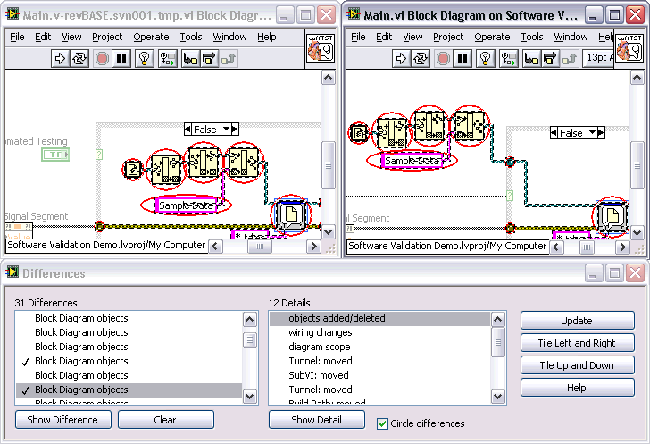
Graphical Differencing
Provides a checklist of changes
Useful for peer reviews
Available via command-line
Notes:
This is an alternative to showing them the diff demo if for some reason it does not work or is not configured correctly.

Slide 22
Separate Compiled Code From Source File Improved Source Code Control Integration
2009
2010
.vi file format
.vi file format*
Front Panel
Block Diagram
Front Panel
Block Diagram
Connector Pane
Icon
Connector Pane
Icon
Compiled Code
Compiled Code
Inplaceness Info
Inplaceness Info
A separate object file is created to store and retain this information
Eliminate the need to re-save and re-submit files to source code control unless the graphical source code has been changed by the developer
*this feature is not on by default and needs to be enabled from the VI Properties dialog
Notes:
This shows the optional feature available in 2010 to remove the compiled code from the VI. The primary benefit and reason to use this feature is that it makes integration with SCC easier by eliminating having to needlessly check files into and our of SCC.

Slide 23
Source Code Control Scenario: Today
Local Machine
In SCC
TopLevel.vi
TopLevel.vi
Edit
SubVI1.vi
SubVI1.vi
SubVI1.vi
SubVI1.vi
Save
Check-in
SubVI2.vi
SubVI2.vi
Notes:
Only pull blue out of SCC
On first load, red is auto created
If version isn’t latest, the red will still be created at latest version, but the blue will not be resaved at latest unless you do so specifically.
If you edit a blue, reds will change as necessary. Only the blue you edited will need to be resubmitted to SCC. Only the solid blocks will need to resave.
Performance:
Only have to load the top blue one and all of the red ones.
Transparent mass compile:
On first load of TopLevel.vi, all the reds are generated and saved. You are not effectively mass compiled. In 2009, you have to resave the blue files in order to really mass compile and not run slow.

Slide 24
Source Code Control Scenario: 2010
In SCC
Local Machine
local .viobj
cache
TopLevel.vi
TopLevel.vi
Edit
TopLevel .viobj
TopLevel .viobj
SubVI1.vi
SubVI1.vi
SubVI1.vi
Sub VI1.vi
SubVI1.vi
Run/Save
SubVI1 .viobj
SubVI1 .viobj
Check-in
SubVI2.vi
SubVI2.vi
SubVI2 .viobj
Notes:
Only pull blue out of SCC
On first load, red is auto created
If version isn’t latest, the red will still be created at latest version, but the blue will not be resaved at latest unless you do so specifically.
If you edit a blue, reds will change as necessary. Only the blue you edited will need to be resubmitted to SCC. Only the solid blocks will need to resave.
Performance:
Only have to load the top blue one and all of the red ones.
Transparent mass compile:
On first load of TopLevel.vi, all the reds are generated and saved. You are not effectively mass compiled. In 2009, you have to resave the blue files in order to really mass compile and not run slow.

Slide 25
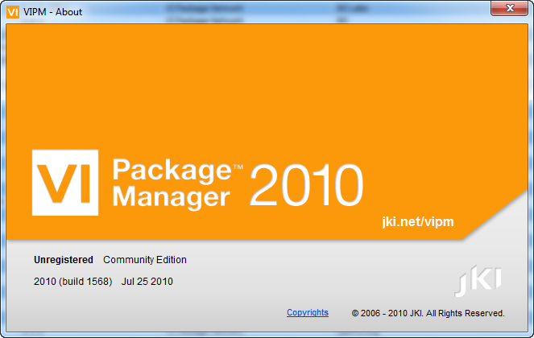
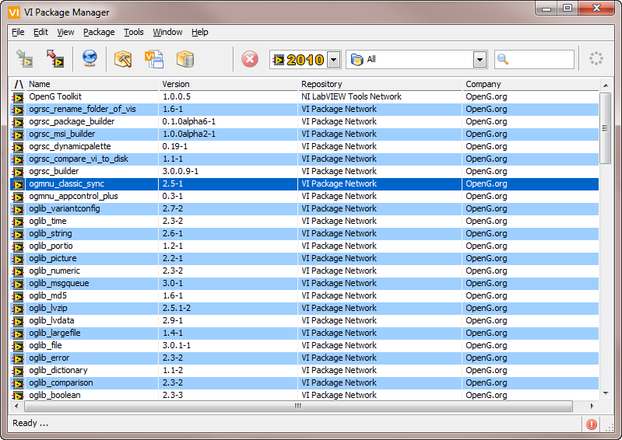
VI Package Manager
Build and manage packages of LabVIEW code
Notes:
The VI Package Manager is often thought of as an application store for engineers, where they can get tools and add-ons for LabVIEW, but it’s also a sophisticated tool for managing reuse libraries and distributing them across multiple developers and multiple projects.
The concept of a package management utility is not unique to LabVIEW, in fact they are quite common across multiple environments.
Reuse libraries typically refer to any atomic, self-contained library of code that is developed and maintained independently of the applications that are using it. As an example, many test applications rely upon standard tools for generating reports, communicating with databases, etc… As these libraries of code should probably be used across multiple projects, it is helpful to store and organize them as reuse libraries.
They should still be developed and stored in SCC, but they don’t have to subscribe to the same repo as any consuming applications.

Slide 26
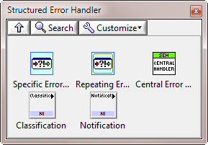

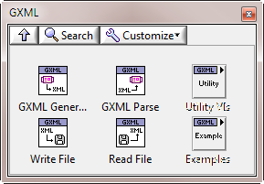
Install and Manage VI Packages
Structured Error Handler
GXML Library
Notes:
These are two examples of simple reuse libraries. VIPM allows you to store them as a package, and does a lot of the work for you regarding the management and organization of any depdencies with other packages and LabVIEW versions. It even allows you to define and install palettes, examples and tool menu items.
Note: The ability to create and install packages is included in the free version now.

Slide 27
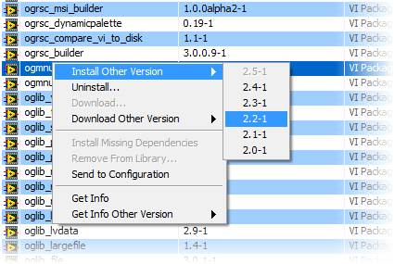
Easily Upgrade and Downgrade Versions
Notes:
And it simplifies the process of migrating between versions. How do you know when a new version is available and how to you get that on your system? Perhaps even more challenging: how do you revert to a previous configuration if you have to maintain or add a feature to a deployed system and don’t want to have to re-validate the use of a newer version of the library?
Everything discussed so far is included in the free version.

Slide 28

Create VI Configuration Files
A single file that contains multiple packages.
Easily share and distribute code that depends upon multiple libraries.
Structured Error Handler
Structured Error Handler Config
GXML Library
AMC Library
G Library
Notes:
If you find yourself having to manage a large number of these libraries, you can use the professional version to create a configuration file, which is a single file that contains all of the required packages. These can even be created automatically by scanning a Project Explorer with VIPM.

Slide 29
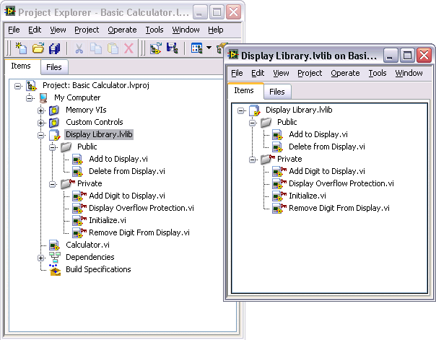
The Project Library
Provide name-spacing to avoid cross-links
Organize sections of an application into components
Modify contents without modifying the Project file
Pack them into a single, non-editable file
Notes:
Project libraries were introduced in LabVIEW 8 as another way to organize related files into an associated library. They provide several nice features, including name spacing and access scope. You probably most commonly see them asosciated with isntrument drivers.

Slide 30
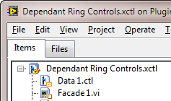
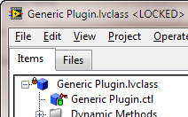
Project Libraries (.lvlib)
Xcontrols (.xctl)
Classes (.lvclass)

Slide 31
Packed Project Libraries New in LabVIEW 2010 Distribute and Deploy LabVIEW Libraries as a Single File
Development Environment
Deployed System
VI
VI
VI
Callers
VI
VI
VI
Callers
lvlib
Project Library
Packed Project Library
VI
VI
VI
VI
Public API
VI
VI
VI
VI
Public API
Compiled
code
Private VIs
Decrease build times
Deploy the VI hierarchy with a single file
Simplified code deployment

Slide 32
Demo
Create a Configuration File by Scanning a Project

Slide 33
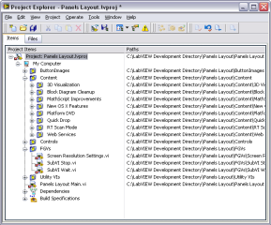
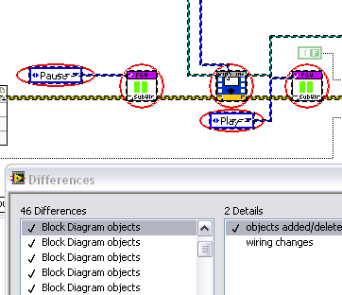
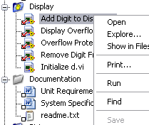
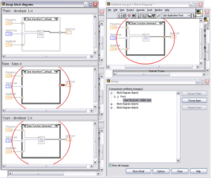
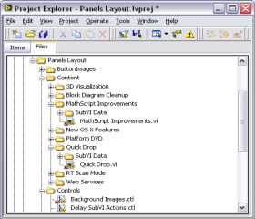
System Level View
Track Changes
Integrate with SCC
Software Configuration Management for LabVIEW
Merge Graphical Code
Manage Files and Links
Manage Reuse Libraries
Notes:
Use this as a summary slide. Note: this is not an exhaustive list, rather it is a way to demonstrate how some common configuration management tasks are performed in LabVIEW.
System Level View – The project explorer in LabVIEW provides developers a system level view of all their resources, including source code, any affiliated files or documentation and even hardware resources, including different platform targets such as RT or FPGA
Track Changes – You can see in this screen shot how LabVIEW can actually indicate exactly what aspects of a block diagram or front panel have been changed or modified. This is made possible thanks to graphical differencing
Integration with SCC – The ability to integrate with SCC from within LabVIEW is advantageous for developers because they can see the current status of files and access generic SCC functionality without leaving LabVIEW
Merge Graphical Code – an important tool for group development requires the ability to combine changes made by multiple developers. This is now possible in LabVIEW 8.5
Manage Files and Links – there are many tools in LabVIEW that have been introduced to address common challenges regarding file management. Moving or renaming files can break links or even cause incorrect links to dependencies on disk. LabVIEW actually allows you to perform these file operations from within the Project in order to preserve correct links and avoid potential cross-link scenarios.
View Revision History – when integration with SCC is turned on you can view all the revisions that have been submitted and stored in the SCC repository. You can even right click on the particular revision and select ‘sync to this revision,’ which pulls down that version of the file. This view also shows and commonts or information about the file from the time when it was checked in.

Slide 34
The Software Engineering Process
Requirements Gathering
Application Architecture
Development
Testing and Validation
Deployment
NI Requirements Gateway
LabVIEW Statechart
Dataflow
Now Included with DevSuite
LabVIEW Unit Test Framework
Application Builder
MathScript
Object Orientation
LabVIEW
VI Analyzer
Real Time
Statechart
FPGA
NI TestStand
Simulation
LabVIEW Desktop Execution Trace
Embedded
Prove it works.
Improve quality. Reduce risk. Save time.
Notes:
Point of this slide
We understand software engineering and we have tools to help
This is a simplified depiction of the software engineering process (there are a bunch!)
People are successful in this process without these tools – they exist to improve and automate existing practices
A process model prescribes specific phases and tasks to accomplish during the development process. While there are many representations of the software engineering ‘process,’ including the waterfall model, the spiral process model, or more contemporary models such as agile or XP (extreme programming) models, perhaps one of the most common and rigorous, the ‘v-model.’
If you look closely at this diagram you’ll notice that it begins with the defining of requirements for the product. These are often high level and are often developed through discussion with the customer or end-user.
One thing to realize is that the level of criticality directly impacts how granular you have to be in this process. You may not need to spend any formal time architecting your application or the specific modules of code, but these are typically very important for large, complex systems.
There are several SEP models, such as Waterfall, Spiral and Agile, but they all share common ground in terms of having these various phases and tasks that have to be completed. Many companies today are leaning more towards increasingly agile methods. Basically, this means that for many it’s unrealistic to abide by a waterfall method, in which you work on a particular phase, then agree that you’re done and move on. In reality, complex applications require a lot of back and forth between these different phases. For example, something in the prototype stage doesn’t work as expected and therefore require a new definition for how a particular part of the application will operate, thereby impacting requirements documentation and other components such as the test framework. We’ll look at how to address some of these common challenges in just a few slides..
You might note that this does not include prototyping, which is an important part of the development process, but not included in this discussion. For many software vendors, prototyping has very close ties to the requirements phase, as the prototyping lends itself towards a better understanding of what the final product will do. We’ll discuss that further when we talk about requirements management.

Slide 35
The Software Engineering Process
Requirements Gathering
Application Architecture
Development
Testing and Validation
Deployment
NI Requirements Gateway
LabVIEW Statechart
Dataflow
LabVIEW Unit Test Framework
Application Builder
MathScript
Object Orientation
LabVIEW
VI Analyzer
Real Time
Statechart
FPGA
NI TestStand
Simulation
LabVIEW Desktop Execution Trace
Embedded
Prove it works.
Improve quality. Reduce risk. Save time.
Notes:
Point of this slide
We understand software engineering and we have tools to help
This is a simplified depiction of the software engineering process (there are a bunch!)
People are successful in this process without these tools – they exist to improve and automate existing practices
A process model prescribes specific phases and tasks to accomplish during the development process. While there are many representations of the software engineering ‘process,’ including the waterfall model, the spiral process model, or more contemporary models such as agile or XP (extreme programming) models, perhaps one of the most common and rigorous, the ‘v-model.’
If you look closely at this diagram you’ll notice that it begins with the defining of requirements for the product. These are often high level and are often developed through discussion with the customer or end-user.
One thing to realize is that the level of criticality directly impacts how granular you have to be in this process. You may not need to spend any formal time architecting your application or the specific modules of code, but these are typically very important for large, complex systems.
There are several SEP models, such as Waterfall, Spiral and Agile, but they all share common ground in terms of having these various phases and tasks that have to be completed. Many companies today are leaning more towards increasingly agile methods. Basically, this means that for many it’s unrealistic to abide by a waterfall method, in which you work on a particular phase, then agree that you’re done and move on. In reality, complex applications require a lot of back and forth between these different phases. For example, something in the prototype stage doesn’t work as expected and therefore require a new definition for how a particular part of the application will operate, thereby impacting requirements documentation and other components such as the test framework. We’ll look at how to address some of these common challenges in just a few slides..
You might note that this does not include prototyping, which is an important part of the development process, but not included in this discussion. For many software vendors, prototyping has very close ties to the requirements phase, as the prototyping lends itself towards a better understanding of what the final product will do. We’ll discuss that further when we talk about requirements management.

Slide 36
Software Design Phase
Prototype
Specifications
System Requirements
Unit Specifications
Test Definitions
Notes:
Prototyping and proof of concepts are a very important step towards developing requirements. It can be very hard to account for all contingencies and foresee all the ways in which the software will behave.
Proof of concepts are also extremely valuable because they give the end-user or customer a feel for what the product will do, which helps developers and users come to a consensus.
Requirements van vary greatly in granularity. This slide depicts deriving system, unit and test requirements from prototyping. Ultimately, it depends upon the granularity required of the software and the people testing the software.
Typically, after these requirements have been generated, they are given to the developers who are then told to create whatever they have been told is required. Throughout their work, they then have the burden of proving or recording where in the application the requirements they were given have been met.
Another part of the process where requirements are key is during testing. As we’ll see when we discuss the debugging phase, it is mandatory that you have an understanding of how the software should behave before testing it.
Requirements gathering is important in order to ensure that you and your customer have come to the same agreement about what the application will do. The granularity of the documents directly depends upon the needs of your application and the criticality of it. For mission-critical systems, it’s typical to go as far as to define the requirements for individual modules of code, code units, and even the tests for those units. Part of this process requires having reached an agreement of what is considered safe, or a graceful way to fail (in the even of hardware failure, etc..)

Slide 37
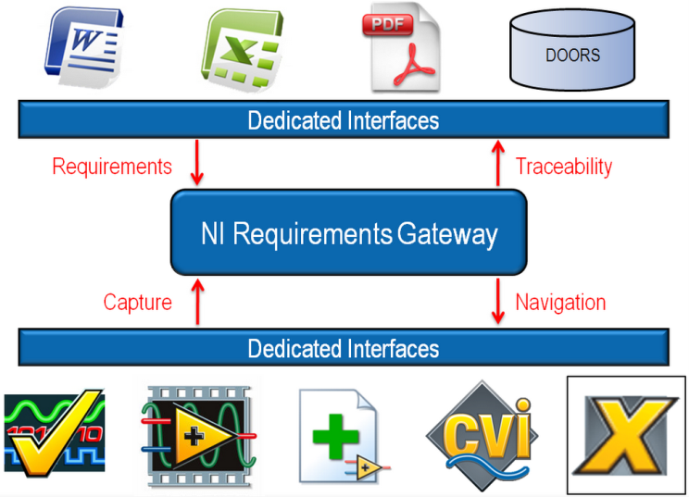
Requirements Traceability Solution from NI
Notes:
NI Requirements Gateway facilitates the tracking of requirements coverage for these three types of documents. Lets take a look at how NI Requirements Gateway does this.
Specification documents can be stored in many different formats. They can be stored in something as simple as text file or complex as a Telelogic DOORS database. All these different document formats have one thing in common. They all have dedicated interfaces so that other applications can communicate with them.
You also have your applications and test sequences that will be covering the requirements defined up top. These applications also have dedicated interfaces so we can find information on what requirements each particular function is covering.
NI Requirements Gateway sits between the requirements documents and applications in order to provide requirements traceability and impact analysis. Requirements located in the different documents will be read by NI Requirements Gateway. At the same time NI Requirements Gateway will be able to capture information from the implemented applications to determine what requirements have already been implemented
NI Requirements Gateway also lets you navigate into the different applications it is communicating with so once you have identified a requirement you can see what feature is covering it and see the code to the feature as well. The software also lets you export traceability information back up into Telelogic DOORS
The orange square determines the part of this system that is a National Instruments product.

Slide 38
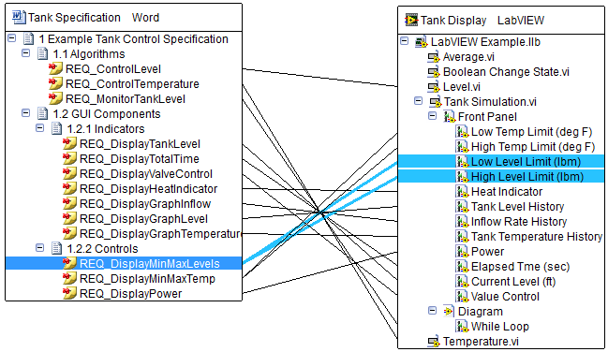
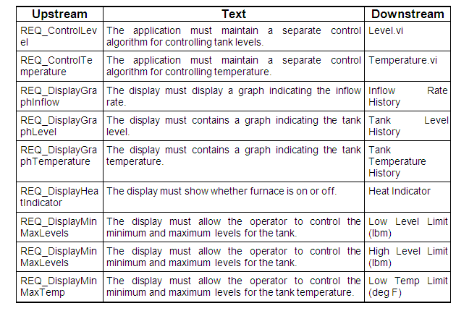
Requirements Gathering
Application Architecture
Development
Debugging & Testing
Deployment
Requirements Coverage and
Project Tracking
Traceability and Documentation
Generation
Notes:
Requirements Traceability
A process that acts as a bridge between the different stages of the software development lifecycle, and provides an auditable trail to verify that each requirement is fulfilled and tested. For example, the design elements in a design document must be traceabile to "parent" requirements in the predecessor requirements document as well as to "child" elements in subsidiary documents, such as the test plan and implementation document. Traceability may be implemented as a table or spreadsheet describing the relationships between application requirements, functional elements, design elements, implementation elements, and test cases. In this case, the table is termed the Requirements Traceability Matrix (RTM). Traceability may also be implemented as an automated process that directly examines the realted documents and reports valid traceability or errors in traceability.
It’s not uncommon to end up with a variety of documents as a variety of this phase, and it may even be necessary to provide traceability between documents. (ie: this system level feature is implemented via this set of code modules).
One of the biggest challenges, in any language, is understanding what sections of your application cover which requirements and therefore what portion of requirements have been fulfilled. From a project management standpoint this is also important in order to gain inside into how far into the project you are.
If the document on the slide looks familiar, that’s because it represents a simple Traceability Matrix. This is a common form used to record where, how and by whom a requirement was implemented or ‘covered.’

Slide 39
DEMO
Requirements Tracking
Notes:
For the demo, use Exercise 2: Tracing Code to Requirements Documents from the Software Engineering Technical Manual

Slide 40
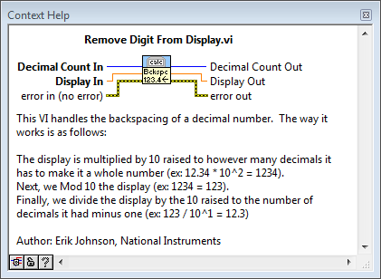
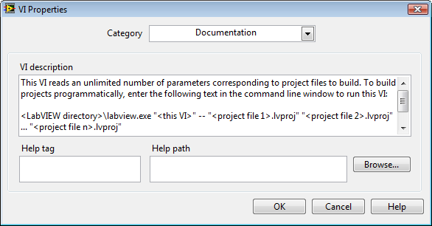
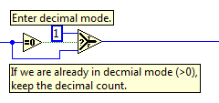
Documentation
Labeled objects
In-line comments
Distinct Icon
Description and Tip
HTML Print-Out
Requirements Coverage
Notes:
If you’ve had the misfortune of seeing poorly documented code, it can be difficult to understand how the code works. There are several simple measures and practices to ensure that code is readable, which helps ensure that it can be reused for a long-period of time. We just looked at requirements management, which really serve as the ultimate form of documentation. This information should also be stored in the VI Information. When getting started with LabVIEW, one of the easiest ways to understand what a VI does is to review the description and tip (shown in top right). You can create this same information for functions that you intend to be given to other developers, perhaps as part of an API.
Graphical code can be self-documenting if written in a clear, logic manner. However, even the most self-documenting application can benefit greatly from additional, or more-in depth documentation.
This is especially true when working on a team of developers where other people may either need to re-use or modify your code. This is also extremely important when tracking and identifying the source of changes through the help of source code control.

Slide 41
Tools for Debugging and Testing
Debugging & Testing
Functional Validation
of Code
Unit Test Framework
Advanced
Dynamic Code Analysis
Desktop Execution Trace
Real Time Execution Trace
Application Complexity
Static Code Analysis
VI Analyzer Toolkit
Simple
Low Risk
High Risk
Application Criticality
Notes:
Testing and debugging software has always been an inseparable part of the development process, but automated tools such as the LabVIEW Unit Test Framework are available to address the challenge of testing complex software. Automating this process reduces the amount of time developers spend performing tests and enables more exhaustive testing. This not only helps to ensure the highest-quality software possible is produced, but it also saves money by catching problems earlier and reducing the amount of time developers spend performing these tests.
We’ve already mentioned several items that these tools and practices can help screen for, such as documentation, sound architecture, etc…

Slide 42
Performing a LabVIEW Code Review
Walk someone through your code
Questions to consider:
Is the code easy to maintain, and has it been documented?
What happens if the code returns an error?
(… or if it receives an error?)
Is too much functionality located in a single VI?
Are there any race conditions?
Is the memory usage within acceptable limits?
Perform code reviews frequently
Notes:
Let’s start off by describing just what a code review is. When you perform a code review, which is sometimes referred to as a code walk, you taking someone through your code and explaining how it works.
There’s an expression about code reviews that goes - “The best code reviews are the ones that actually get done.” Any attempt to review your code is going to beneficial.
The idea behind a code review is that in having another set of eyes look at your code will help you find problems, but, in fact, most issues discovered during a code review are identified by the developer while explaining how everything.
Once you feel the code is ready to reviewed, meaning you think it is finished, you have to choose your reviewer. This is an important consideration because you need to choose someone who understands LabVIEW and can give constructive, sound feedback. It’s not effective to choose a reviewer who only understands C because too much time is spent explaining the principles behind LabVIEW.
In our LabVIEW R&D groups, we have a general rule of thumb that we use: for bug fixes or relatively minor new features and changes, it’s OK for a peer to review the code. For new programs or major new features, the group manager will perform the code review.
Once you sit down with your reviewer to walk through your code, you’re going to show them the main path through your code and answer any questions that they may have. Remember that your code should be reflective of the agreed-upon design, the discussion should focus primarily on the architecture of the code (i.e. state machine, producer/consumer, etc.). Some of the topics that may be discussed include how easy the architecture of the code makes it to add a new feature or makes changes, how errors are reported and handled, and whether the code is modular enough. If global or local variables are used, you should explain how you have eliminated the possibility of race conditions. You can also demonstrate that the code doesn’t starve the processor or use a prohibitive amount of memory.
Overall, you’re showing your reviewer that you’ve created clean, robust code that will achieve the requirements set out much earlier in the SW development cycle.
And now Eric, who is representing R&D today, is going to demonstrate the type of code review that you would find in LabVIEW R&D here at NI.

Slide 43
Establish or Adopt Development Guidelines
Front Panel Style
Fonts and Text Characteristics
Colors
Graphics and Custom Controls
Layout
Sizing and Positioning
Labels
Paths versus Strings
Enumerated Type Controls versus Ring Controls
Default Values and Ranges
Property Nodes
Key Navigation
Dialog Boxes
Style Checklist
VI Checklist
Front Panel Checklist
Block Diagram Checklist
Block Diagram Style
Wiring Techniques
Memory and Speed Optimization
Sizing and Positioning
Left-to-Right Layouts
Block Diagram Comments
Call Library Function Nodes and Code Interface Nodes
Type Definitions
Sequence Structures
Icon and Connector Pane Style
Icons
Example of Intuitive Icons
Connector Panes
NI Style Guideline: ni.com/largeapps
Notes:
This list illustrates just some of the many different items and criteria that it’s important to screen for during a code review. There are many more, and many that are specific to certain types of applications and hardware targets.
National Instruments coordinates thousands of developers around the world that are developing applications in a variety of different languages, including LabVIEW. As a result, code reviews are an important part of this process, but we use tools to help identify potentially problematic areas that require additional attention.

Slide 44
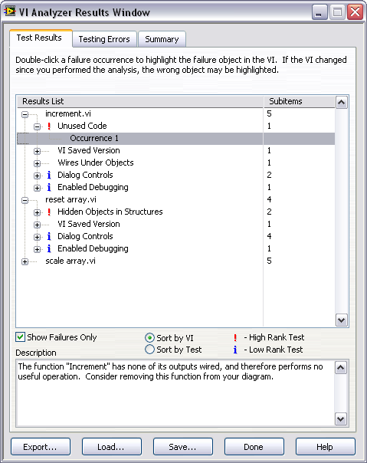
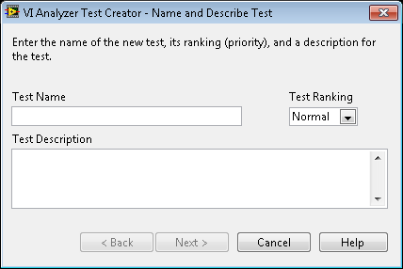
Preparing for a Code Review with VI Analyzer
Automate code analysis with 80+ configurable tests
Performance
Style
Complexity
Interactively inspect failures
Generate custom reports
Code complexity metrics
Write your own tests with VI Scripting LabVIEW 2010
Notes:
In order to simplify the process, you need to take advantage of tools that can help automate the code inspection and help identify improvements. One example is the LabVIEW VI Analyzer tool, which is an add-on for LabVIEW 7 and 7.1 that analyzes any LabVIEW code and then steps the user through the test failures. You can also generate reports that allow you track code improvements over time, and can be checked into source code control software along with your VIs.
Static code analysis refers to any tool or method that has pre-established criteria by which it can compare source code to see if it meets standards for style, organization and technique. This can be performed prior to, or even without, compilation or execution of the application.
Thanks to the release of VI Scripting, it’s now possible to create your own VI Analyzer test.

Slide 45
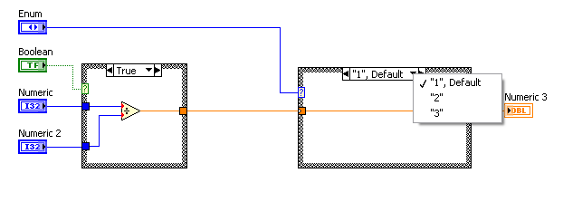
VI Analyzer Code Complexity Metrics Tests for Industry Standard Metric Calculations
Edges = 5 Nodes = 3 Paths = 1
True
Case 1
Case 2
False
Case 3
Cyclomatic complexity: 5 – 3 + 2 (1) = 4
Notes:
Understanding complexity helps software test planning. Going back to that ugly diagram we saw earlier, the metics we can use to assess the quality of the code include testability of a diagram. It should be simple and well encapsulated, meaning that their should only be a small number of logical combinations of execution paths through a single function. Metrics like cyclomatic complexity can help us understand this.
Other Code Complexity Metrics include:
Cycolmatic complexity
Fan in / fan out
Modularity index
Depth of structure nesting
Node density
Wire crossings

Slide 46
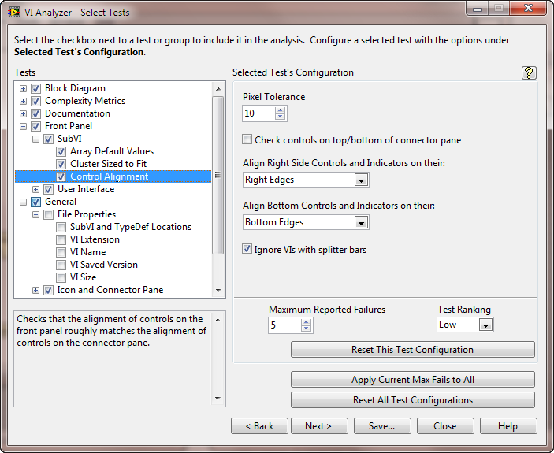
Creating Custom Tests
Select tests to run
Test specific configuration settings
Number of failures to report
Test Priority

Slide 47
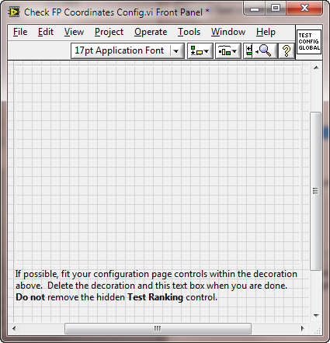
Define Configuration Options
Access values in test code using
Global variables

Slide 48
DEMO
VI Analyzer for Peer Reviews
Notes:
For the demo, use Exercise 3: Analyzing Code Quality from the Software Engineering Technical Manual

Slide 49
Tools for Debugging and Testing
Debugging & Testing
Functional Validation
of Code
Unit Test Framework
Advanced
Dynamic Code Analysis
Desktop Execution Trace
Real Time Execution Trace
Application Complexity
Static Code Analysis
VI Analyzer Toolkit
Simple
Low Risk
High Risk
Application Criticality
Notes:
Now we’re going to look at the Desktop Execution Trace Toolkit and see how we can use it to perform dynamic code analysis. This will be helpful when struggling to locate the source of difficult to find, or difficult to reproduce issues.
Trace the execution of LabVIEW VIs on a Windows target during run-time to detect and locate problems in code that could impact performance or cause unexpected behavior. The Desktop Execution Trace Toolkit provides a chronological view of system events, queue operations, reference leaks, memory allocation, un-handled errors, and the execution of subVIs. Users can also programmatically generate user-defined events from the block diagram of a LabVIEW application.

Slide 50
Goals of Dynamic Code Analysis:
What is consuming system memory?
Am I capturing all the errors in my application?
What was the last event to occur before…?
What was the call-chain that led us to…?
What thread is it executing in?
Am I actually entering a specific event-case?
What happened inside a structure?
What order to these events occur in?
Is a daemon process running in the background?
Does the code behave different in an executable?
Notes:
Dynamic code analysis has a number of different use-cases throughout the software development life-cycle, including:
Detecting memory and reference leaks
Isolating the source of a specific event or undesired behavior
Screening applications for areas where performance can be improved
Identifying the last call before an error
Ensuring the execution of an application is the same on different targets
Identifying the source and fixing the cause of unexpected or undesirable behavior in software can be a tedious, time-consuming and expensive task for developers. Even code that is syntactically correct and functionally complete is often still contaminated with problems such as memory leaks or daemon tasks that can impact performance or lead to incorrect behavior. These oversights can be difficult to reproduce and even more difficult to locate, especially in large, complex applications.
LabVIEW developers can take advantage of a number of tools for a combination of static and dynamic code analysis to screen for problems and isolate their cause. These tools can reduce the time spent tracking down problems, while providing more exhaustive and complete analysis of the software. This article will provide an overview of the Desktop Execution Trace Toolkit and how it can be used for dynamic analysis of LabVIEW applications.

Slide 51
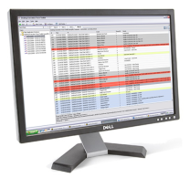

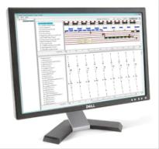

Trace Production Systems Remotely
LabVIEW Desktop Execution Trace Toolkit
Network
VIs and Debuggable Executables
Run-Time Execution Information
LabVIEW Real-Time Execution Trace Toolkit
Network
Deployed Real-Time Applications
Run-Time Execution Information
Notes:
Problems such as memory leaks can have costly consequences for systems that are required to sustain operation for extended periods of time or for software that has been released to a customer. If software that needs debugging has been deployed and the LabVIEW development environment is not installed on the current machine, it may be beneficial to perform dynamic analysis of the code with the Desktop Execution Trace Toolkit over the network. For deployed systems, even if the development environment is available, it may be impractical or difficult to locally troubleshoot or profile the execution of a running system.
When developing an application that will be remotely monitored, you must enable network communication with VI Server from the options menu. For remote tracing of a VI in the development environment, make sure that the TCP/IP communication is turned on and select a port that is not currently in use (default is 3363). You’ll also need to ensure that machine access is enabled for the terminal where the Desktop Execution Trace is located. For remote tracing of an executable or shared library, you’ll need to enable debugging from the build specifications menu and ensure that the VI Server port is available.
Note that there is a counterpart for tracing RT systems.

Slide 52

Desktop Execution Trace Toolkit
Trace During Run-Time:
Event Structures
Memory Allocation
Queues / Notifiers
Reference Leaks
Thread ID
Unhandled Errors
Dynamic / Static SubVIs
Custom User Strings
Notes:
Trace the execution of LabVIEW VIs on a Windows target during run-time to detect and locate problems in code that could impact performance or cause unexpected behavior. The Desktop Execution Trace Toolkit provides a chronological view of system events, queue operations, reference leaks, memory allocation, un-handled errors, and the execution of subVIs. Users can also programmatically generate user-defined events from the block diagram of a LabVIEW application.

Slide 53
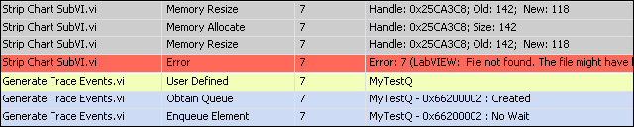
Desktop Execution Trace Toolkit
Trace During Run-Time:
Event Structures
Memory Allocation
Queues / Notifiers
Reference Leaks
Thread ID
Unhandled Errors
Dynamic / Static SubVIs
Custom User Strings
Notes:
While all of the mentioned use-cases are appropriate, it is perhaps the most useful to know exactly what you’re looking for or where you’re looking for it. This makes it easier to sort through the information to find details that can help address your specific concern.
Problems such as memory leaks can have costly consequences for systems that are required to sustain operation for extended periods of time or for software that has been released to a customer. If software that needs debugging has been deployed and the LabVIEW development environment is not installed on the current machine, it may be beneficial to perform dynamic analysis of the code with the Desktop Execution Trace Toolkit over the network. For deployed systems, even if the development environment is available, it may be impractical or difficult to locally troubleshoot or profile the execution of a running system.

Slide 54
DEMO
Dynamic Code Analysis with Desktop Execution Trace Toolkit
Notes:
For the demo, use Exercise 4: Debugging Unexpected Behavior from the Software Engineering Technical Manual

Slide 55
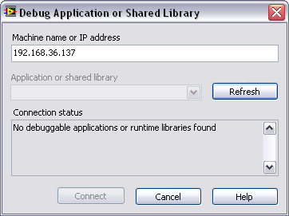
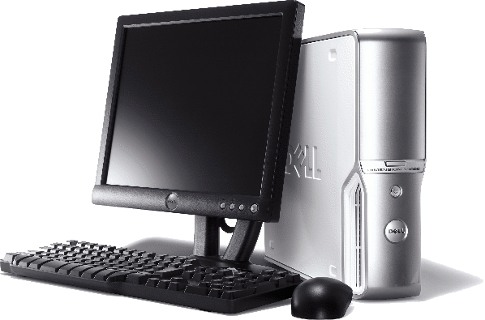
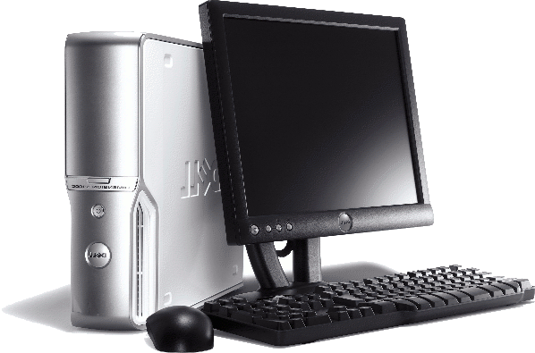



Remote Debugging of Executables
Include block diagrams with an executable
Remotely troubleshoot using LabVIEW debug tools
Notes:
When creating the build specification for an Application (EXE) or Shared Library (DLL), the user has the option to select Enable Debugging. If selected, a user can debug the EXE or DLL from the LabVIEW development environment. The Enable Debugging tool provides the user access to all of the debugging tools that LabVIEW has to offer, including probes, breakpoints, highlight execution, and single-step execution. If debugging is enabled, the end user can debug the EXE or DLL from the LabVIEW environment by going to Operate » Debug Application or Shared Library. This new feature is not restricted on debugging on a local PC; you can also remotely debug an executable or DLL over a network by providing an IP address to connect to from the LabVIEW environment.

Slide 56
Tools for Debugging and Testing
Debugging & Testing
Functional Validation
of Code
Unit Test Framework
Advanced
Dynamic Code Analysis
Desktop Execution Trace
Real Time Execution Trace
Application Complexity
Static Code Analysis
VI Analyzer Toolkit
Simple
Low Risk
High Risk
Application Criticality
Notes:
Functional validation and testing of code is a well-recognized part of the software engineering process and standard practice for anyone who has to ‘prove it works.’ Proving software works is more complex than merely showing that the application runs; it requires validating that it works correctly. This task requires documentation and test results that demonstrate that the application behaves exactly in the way it was designed – evidence that may be required by the customer, a quality assurance group, or even regulatory authorities, such as the FDA or FAA.
Large projects typically augment manual procedures with tools such as the Unit Test Framework to automate and improve this process. Automation mitigates risk of undetected errors, saves costs by detecting problems early, and saves time by keeping developers focused on the task of writing the software, instead of performing the tests themselves.

Slide 57
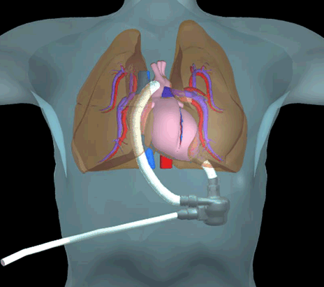
Data Science Automation
Developed Long-term testing solution for artificial hearts
"The Unit Test Framework’s flexibility and ease of use certainly enabled much faster and reliable completion of this portion of the project potentially saving hundreds of hours and thousands of dollars over the life of the project."
Notes:
This is a user solution that is available from ni.com on the role of the Unit Test Framework in a large application. The success of this artificial heart monitoring application was dependent upon 100% up time, which was ensured due to regular regression testing and unit testing with the unit test framework.

Slide 58
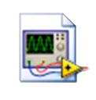
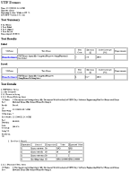
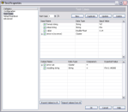
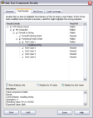

LabVIEW Unit Test Framework
Input Values
Output
VI Under Test
Unit Test
Framework
Expected Output
Automated
Report Generation
Test vector = Input value(s) + Expected output(s)
Notes:
The idea behind unit testing is elegant and simple, but can be expanded to enable sophisticated series of tests for code validation and regression testing. A unit test is strictly something that ‘exercises’ or runs the code under test. Many developers manually perform unit testing on a regular basis in the course of working on a segment of code. In other words, it can be as simple as ‘I know the code should perform this task when I supply this input; I’ll try it and see what happens.’ If it doesn’t behave as expected, the developer would likely modify the code and repeat this iterative process until it works.
The problem with doing this manually is that it can easily overlook large ranges of values or different combinations of inputs and it offers no insight into how much of the code was actually executed during testing. Additionally, it does not help us with the important task of proving to someone else that it worked and that it worked correctly. The cost and time required is compounded by the reality that one round of testing is rarely enough; besides fixing bugs, any changes that are made to code later in the development process may require additional investment of time and resources to ensure it’s working properly.
The ability to prove it works requires the creation of documentation or evidence that the software fulfills its’ intended purpose and meets all other criteria. The LabVIEW Unit Test Framework enables automated generation of documentation in XML (ATML), HTML or ASCII formats. Information included in this report can be configured, but typically includes the time of test, duration of each test, test vector inputs, the results, and aggregated code coverage metrics.

Slide 59
LabVIEW Unit Test Framework
Windows Desktop
Input Values
Output
VI Under Test
Unit Test
Framework
Expected Output
Automated
Report Generation
Test vector = Input value(s) + Expected output(s)
Notes:
Runs on Windows

Slide 60
LabVIEW Unit Test Framework
Real Time
Input Values
Output
VI Under Test
Unit Test
Framework
Expected Output
Automated
Report Generation
Test vector = Input value(s) + Expected output(s)
Notes:
Runs on Real-Time

Slide 61
DEMO
Unit Testing
Notes:
For the demo, use Exercise 5: Unit Testing and Validation of Code from the Software Engineering Technical Manual

Slide 62
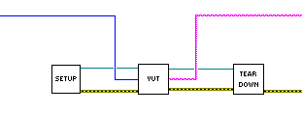
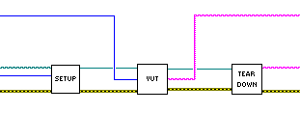

Setup / Teardown VIs
Input
Values
Value
Comparison
Notes:
This slide builds upon the definition of a test vector by explaining how more sophisticated testing can be performed through the use of setup and teardown VIs.
This is useful if:
- your VI has to be in a particular state when under test
- a file or database has to be in a particular state when under test
- you need to pass in a very large or programmatically generated data type (like a 1,000 sample array)
Setup and teardown VIs allow for advanced testing of VIs that have to be in a particular state or require large, complex data. Users can also define custom tests that are called from the framework and included in the generated reports. A palette for programmatic control of tests is installed with the Unit Test Framework toolkit.

Slide 63


Code Coverage Example
6 Diagrams. 3 Diagrams Executed. 50% Code Coverage
Notes:
Explanation of code coverage
****
Code coverage is a metric that is used to refer to the amount of code that was ‘covered’ or executed in the course of testing. Depending upon the level of complexity and criticality, some authorities mandate that all code be exercised in order to mitigate risk of un-tested code and application states that could result in unexpected behavior.
The LabVIEW Unit Test Framework tracks code coverage for every individual test vector. It aggregates these percentages across all tests to identify what code has been left uncovered. The Unit Test Framework Results Dialog lists all percentages and documents the uncovered code. Clicking on this list in the dialog displays and highlights the exact location of this code

Slide 64


Code Coverage Example
1ST Test Vector:
Block diagram, 2 Case diagrams executed. ( 2 + 1 ) / 6 = 50% Code Coverage
2nd Test Vector (aggregates covered code from 1st pass)
Block diagram, 5 Case diagrams executed. ( 4 + 1 ) / 6 = 83.33% Code Coverage
Notes:
In addition to giving insight into the percentage of code that has been covered, it’s important that we track the amount of code that’s ‘touched’ throughout multiple iterations of the tests and multiple test vectors. As shown here, if we pass in a second set of values, we’ve now covered 83.3% of our code. UTF can track these tests and aggregate the total amount of code that was covered throughout testing.

Slide 65


Programmatic Unit Testing
Programmatically invoke testing and report generation
Notes:
Point out that these tests can be invoked and run programmatically. This is especially useful when combined with programmatic build processes. This palette is installed with the toolkit. It also allows us to open the results dialogue and create a report.

Slide 66

Integration with Requirements Gateway
Implementation
Software Requirements
Unit Tests
Test Results
Notes:
A large part of software validation is the ability to demonstrate where and how requirements have been covered through implementation in software. For many, this requires the creation of a traceability matrix, which pairs the requirement with the location in the code where the requirement was covered. Depending upon the level of scrutiny, it may also be necessary to demonstrate where tests for software have been implemented. For this reason, the Unit Test Framework enables developers to enter one or more Requirements IDs in the ‘Configuration’ category
This requirement ID can be parsed by National Instrument’s requirements management tool, NI Requirements Gateway, to automate test requirements management and track coverage.
The requirements that define how code will be implemented and how tests will be performed are typically completed and considered ‘locked’ before development begins – especially when abiding by a test-driven development process model. However, the reality is that modifications to requirements are almost inevitable as a result of unforeseen changes or feature creep. For this reason, a combination of requirements management and configuration management tools are necessary towards providing insight into what code is impacted and therefore may need to be re-validated or tested.

Slide 67







LabVIEW User Interface Testing
Notes:
I want to briefly mention this 3rd party product for automated user interface testing
http://sine.ni.com/nips/cds/view/p/lang/en/nid/209032
The LabVIEW Plug-In for Ranorex enables the automation of manual user interaction performed on LabVIEW front panels. By taking advantage of integrated plug-in use within the Ranorex Test Automation Framework, you can reduce manual work on the VIs used to perform simple test scenarios, which saves you time and money. With the help of the Ranorex Recorder, you can simply capture the user’s interactions, such as clicking on buttons or setting values, and replay them afterward. Additionally, you can replay the recorded user actions much faster and more reliably at any time. During recording, the Validation feature offers capabilities to not only check states and values of controls but also compare images for correctness. Moreover, the recorder helps you execute all steps using a simple .exe file. This simplifies integrating the recordings with an already existing testing environment. The Ranorex add-on is not limited to LabVIEW VIs. The automation of Web interfaces and standard client-based applications is possible as well. You can set up a system test automation process to check functionality through an entire product chain.

Slide 68


Requirements Gathering
Application Architecture
Development
Debugging & Testing
Deployment
Programmatic build processes
Programmatic control of source code control
Notes:
For large software vendors, it is common to combine programmatic checking out of files with programmatic unit testing as well as with programmatic building. That way, when you come into work the next day, you can see if it built and whether or not all the automated test suites passed or not.
Many applications require frequent compilation into an executable (.exe) or a dynamic link library (.dll). An application might require building the source code into an executable every night or every ten minutes. Prior to LabVIEW 8.0 the application builder required the creation of a unique *.bld file to correspond to every configuration your application required. You could then call that file from a batch file.
When the LabVIEW project was introduced in LabVIEW 8.0, build specifications were integrated into the project. To provide the previous capability of batch compilation, LabVIEW now provides a VI called BuildTargetBuildSpecification.vi that programmatically builds a distribution using a predefined build specification. This example shows how to use that feature to batch build applications from the command line. This enables you to build applications from a task automation program such as Windows Task Scheduler.
Any LabVIEW version 8.0 or later with Application Builder installed has this function available in <LabVIEW directory>\vi.lib\AppBuilder.

Slide 69



Application Builder API New in LabVIEW 2011 Automate build and deployment processes

Slide 70


App Builder Log-File Generation
Document version, date and time of Vis included in build
Available in LabVIEW 2009

Slide 71
NI LabVIEW Certifications Align with Training
Developer
Senior Developer
Software Architect
/ Project Manager
Advanced
Architectures
in LabVIEW
Certified LabVIEW Associate Developer
Certified LabVIEW Developer
Certified LabVIEW Architect
LabVIEW
Core 1
LabVIEW
Core 2
LabVIEW Core 3
Managing Software Engineering in LabVIEW
LabVIEW
Connectivity
LabVIEW
Performance
Recommended course
Optional course
Object-Oriented Design & Programming in LabVIEW
Optional certification
"Certification is an absolute must for anyone serious about calling himself a LabVIEW expert... At our organization, we require that every LabVIEW developer be on a professional path to become a Certified LabVIEW Architect."
- President, JKI Software, Inc.
Notes:
There is a close link between training and certification.
Certification is a quantifiable way of ensuring individuals have developed the skills need to create applications.
NI also offers certifications for LabWindows/CVI and TestStand

Slide 72
More Information on Architectures and Process Dedicated to LabVIEW Development and Software Engineering Practices
Technical White Paper Series
ni.com/largeapps
Online Community Dedicated to Development Best Practices
ni.com/community/largeapps
Follow My Blog on Software Engineering with LabVIEW
ekerry.wordpress.com
Follow me on Twitter
elijah286

